Slide 1
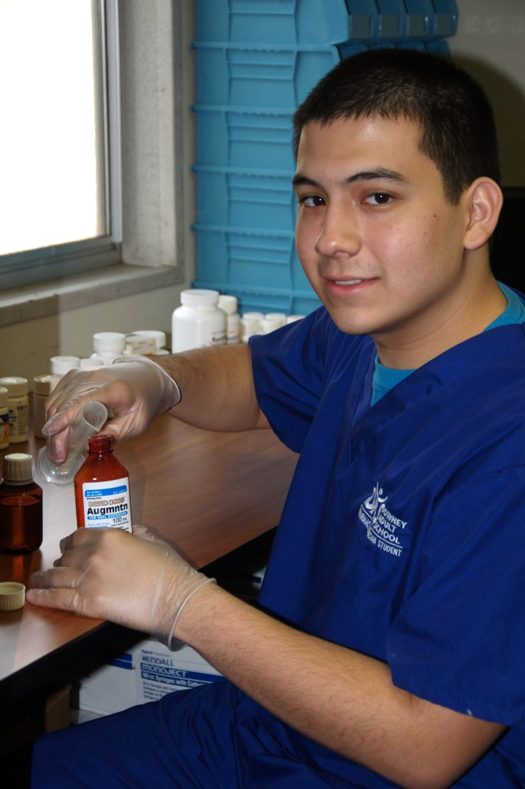
Pharmacy Technician
Program Orientation

Slide 2
What is the Pharmacy Technician Program?
The Pharmacy Technician program is a vocational training course which will provide students with the basic skills and knowledge in preparation for an entry-level pharmacy technician position. In addition to classroom instruction, students will also be required to complete a 120-hour externship with a school-approved facility and apply for state registration with the California Board of Pharmacy.

Slide 3
Program Requirements
High School diploma or equivalent (GED)
Copy of TB skin test results
TB skin tests must be less than a year old
Copy of Hepatitis B immunization records
Yellow immunization card, baby book, etc.
CPR Certification - $57 separate course fee

Slide 4
Program Requirements for State Registration
These requirements are to be furnished after the classroom instruction, prior to externship:
$105 application fee (personal check, money order, cashier check)
2” x 2” passport-style photo
Official High School/GED transcripts
Official Self Query Results from the NPDB
Copy of Livescan fingerprint form

Slide 5
Text References Students are required to have books by the first day of class. Prices are based on retail prices from http://paradigm.emcp.com.
Pharmacology for Technicians, 5th Edition by Don A. Ballington and Mary M. Laughlin
ISBN# 978-0-76385-233-7 Price: $105.24
Pharmacy Calculations for Technicians, 5th Edition by Don A. Ballington and Tova Wiegand Green
ISBN# 978-0-76385-221-4 Price: $79.91
Pharmacy Practice for Technicians, 5th Edition by Don A. Ballington and Robert J. Anderson
ISBN# 978-0-76385-226-9 Price: $105.24
Labs for Pharmacy Technicians, 2nd Edition by Jason Sparks
ISBN# 978-0-76385-239-9 Price: $90.58

Slide 6
Program Content
Basic Concepts of Pharmacology
Pharmacy Law and Regulation
Basics in Sterile and Non-Sterile Compounding
Medication Safety
Pharmacy Quality Assurance
Medication Order Entry and Fill Process
Pharmacy Inventory Management
Pharmacy Billing and Reimbursement
Pharmacy Information System Usage and Application
Job Preparation Skills

Slide 7
Program Length (excluding externship hours)
Morning Session (2 classes)
25 weeks (5 modules)
Monday to Friday
8:30 am – 12:30 pm
Evening Session
30 weeks (6 modules)
Monday to Thursday
5 pm – 9 pm

Slide 8
Externship
Upon successful completion of the classroom instruction portion, students will be placed in a school-approved facility to complete 120 hours of externship.
Prior to externship placement, all students are required to be cleared with a background check and drug screening.
Students will be given up to 6 weeks to complete.
Failure to complete will result to failing the program.

Slide 9
Program Format
Modular format
Grading system composed of 5-week modules, to be each given a specific grade. All module grades will be averaged to attain a final program grade.

Slide 10
Program Format
First module will be an blended module
Monday to Thursday, self-paced online
Thursday Lab, 1pm to 5pm, Room E-31
Students are required to attend a 2-hour module introduction on the first day of class
Room TBD, 10:30am to 12:30pm
All remaining modules there after are in-class

Slide 11
Program Format
Students will be assessed with a module final exam at the end of each module.
Grades will be averaged at the end of the 25/30-week instructional portion of the course for the final grade.
Students need to pass the instructional portion with a grade of C (75%) or better in order to advance to the externship portion of the program.

Slide 12
Grading Criteria
The following categories may apply to all or some modules.
Classroom Attendance and Participation | 10%
Assignments and Software Lab Exercises | 15%
Pharmacy Practice Lab | 25%
Quizzes, Tests and Projects | 25%
Final Exam | 25%
Total (per module) | 100%

Slide 13
Module Repeat Policy
Students who do not pass a module will need to repeat that specific module when offered again. Each module is $599.83 for the AM session and $499.83 for the PM session. All modules must be successfully completed to finish the classroom instruction portion and move to externship. A student who fails two (2) modules will need to repeat the whole program.
If the student still fails the repeat module, the student will need to re-enroll into the program. Current enrollment fees will apply.

Slide 14
Attendance Policy
Students are expected to attend class daily and punctually.
2 Tardies = 1 absence
3 Absences = Drop from module
Students are required to make up any counts of tardiness or absences. Only 12 make up hours are allowed.

Slide 15
Cheating Policy
There is a zero-tolerance policy on any type of cheating.
Subject to dismissal from the program.
Plagiarism is considered cheating.

Slide 16
Uniform Policy
Students are required to wear Royal Blue Medical uniforms in campus at all times.
Estimated Cost: $25/set with embroidery
Supplier:
Cindy’s Uniforms
12270 Woodruff Avenue,
Downey, CA 90241
562-803-6754
Footwear: Closed-Toe shoes are required.

Slide 17
Uniform Policy
Excessive jewelry is prohibited.
Facial piercings are prohibited.
Always look professional.

Slide 18
Course Enrollment Fees
Registration Fee: $2999.00, excluding
Books
Uniforms
Background check and drug screening fee
Down Payment: $700.00
Accepted forms of payment
Cash
Check
Credit Card (Visa, Mastercard)

Slide 19
Course Enrollment Financial Aid
Apply at www.fafsa.ed.gov
Input School Code: 005638
Once online application is processed, student must make an appointment to meet with FA department.
Any other questions?
Email financialaid@das.edu

Slide 20
Course Enrollment How-to
Student enrollments are on a first-come, first-serve basis.
Contact Person:
Janet Gera, Clerical Support
Front Office
Students must make the down payment to secure a spot.
Any remaining balance will be divided into monthly payments and must be paid in full prior finishing classroom instruction.

Slide 21
Course Refund Policy
Students may receive a refund if requested before the third day of class.
DAS will deduct a 15% processing fee from all refunds.
Absolutely no CASH refunds.
A refund will be issued within 4 weeks of request.
All refunds must be requested in writing.

Slide 22
Any Questions?
dlegaspi@das.edu

